Slide 1

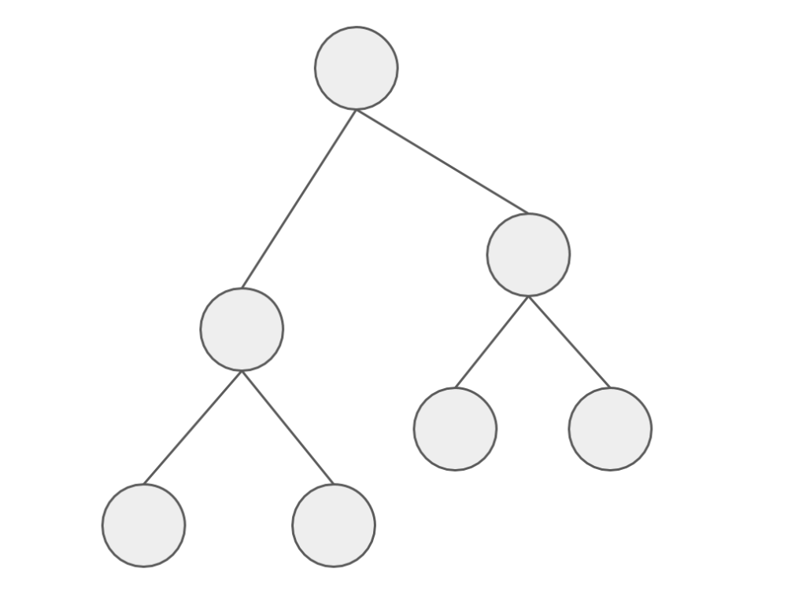
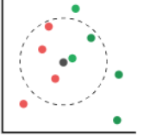
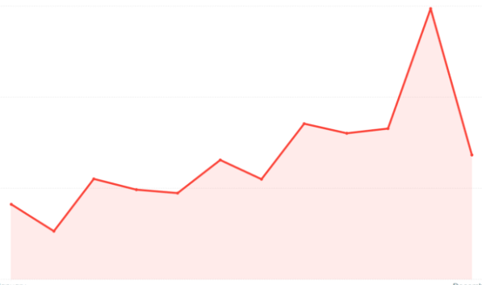
Models
Random Forest Regressor
LGBM Regressor
KNN
Facebook Prophet
Notes:
-To help users explore all listings available in NYC, we created a marker cluster map using Leaflet.
-The clusters display the number of listings with the different boroughs and neighbourhoods in NYC.
-In this example, we selected the the well-known New York borough of Manhattan, and then further zoomed in to the Upper West Side neighbourhood.

Slide 2
Model Data Transformation
Notes:
-To help users explore all listings available in NYC, we created a marker cluster map using Leaflet.
-The clusters display the number of listings with the different boroughs and neighbourhoods in NYC.
-In this example, we selected the the well-known New York borough of Manhattan, and then further zoomed in to the Upper West Side neighbourhood.

Slide 3
Next Steps…
A major area of concern for cities worldwide is the effect that expansion of Airbnb has made on the housing market for indigenous residents.
Further analysis can help determine if there is a correlation between Airbnb listings and rental/house prices for NYC neighbourhoods.

